Slide 1
Do It! 2: Adjusting Entries for Deferrals (4 of 5)
The ledger of Hammond Company, on March 31, 2020, includes these selected accounts before adjusting entries are prepared.
 | Debit | Credit
Prepaid Insurance | $ 3,600
Supplies | 2,800
Equipment | 25,000
Accumulated Depreciation—Equipment |  | $5,000
Unearned Service Revenue |  | 9,200
Prepare the adjusting entries for the month of March.
The equipment depreciates $200 a month.
Depreciation Expense
200
Accumulated Depreciation—Equipment
200
L O 2

Slide 2
Do It! 2: Adjusting Entries for Deferrals (5 of 5)
The ledger of Hammond Company, on March 31, 2020, includes these selected accounts before adjusting entries are prepared.
 | Debit | Credit
Prepaid Insurance | $ 3,600
Supplies | 2,800
Equipment | 25,000
Accumulated Depreciation—Equipment |  | $5,000
Unearned Service Revenue |  | 9,200
Prepare the adjusting entries for the month of March.
During March, services were performed for $4,000 of the unearned service revenue reported.
Unearned Service Revenue
4,000
Service Revenue
4,000
L O 2

Slide 3
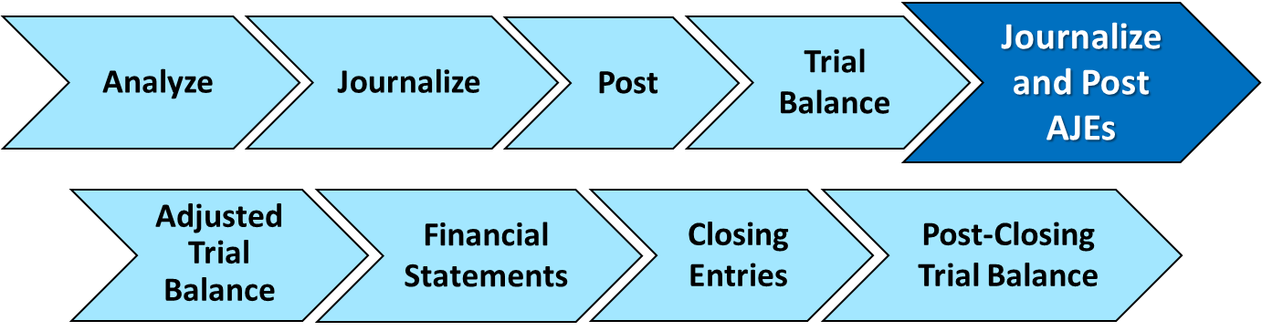
Adjusting Entries for Accruals
LEARNING OBJECTIVE 3
Prepare adjusting entries for accruals.
Accruals are made to record,
Revenues for services performed but not yet recorded at the statement date
Expenses incurred but not yet paid or recorded at the statement date
L O 3

Slide 4
Accrued Revenues (1 of 5)
Revenues for services performed but not yet received in cash or recorded.
Revenue Recorded BEFORE Cash Receipt
Accrued revenues often occur in regard to:
Rent
Interest
Services
L O 3

Slide 5
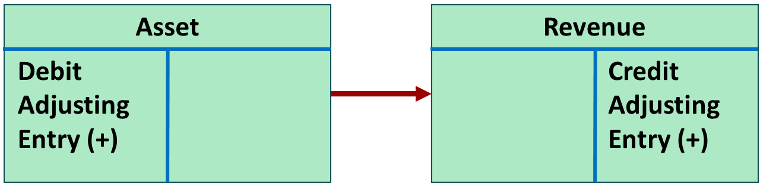
Accrued Revenues (2 of 5)
Adjusting entry records the receivable that exists and records the revenues for services performed.
Adjusting entry:
Increases (debits) an asset account and
Increases (credits) a revenue account.
L O 3

Slide 6
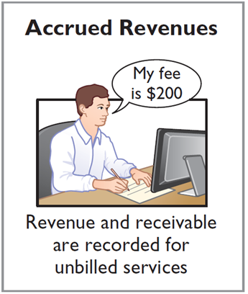
Accrued Revenues (3 of 5)
Illustration: In October, Pioneer Advertising performed services worth $200 that were not billed to clients on or before October 31.
Oct. 31
Accounts Receivable
200
Service Revenue
200
On November 10, Pioneer receives cash of $200 for the services performed. The journal entry on the 10th is:
Cash
200
Accounts Receivable
200
L O 3

Slide 7
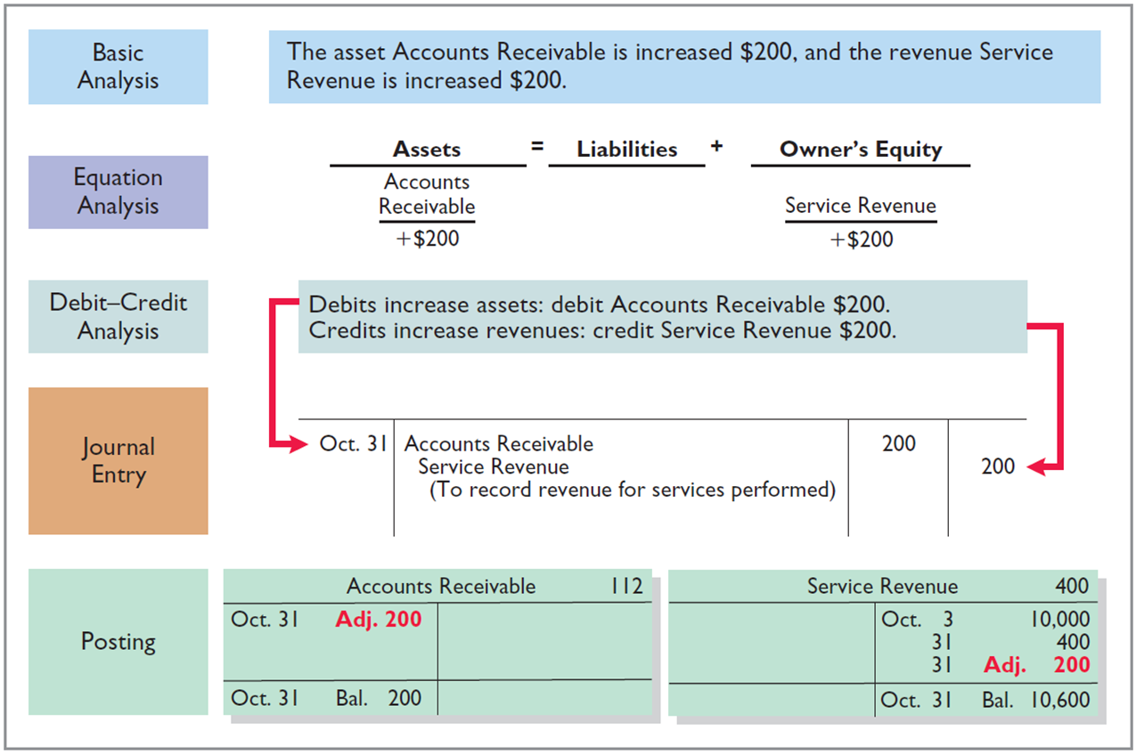
Accrued Revenues (4 of 5)
L O 3

Slide 8
Accrued Revenues (5 of 5)
Accounting for Accrued Revenues
Examples | Reason for Adjustment | Accounts Before Adjustment | Adjusting Entry
Interest, rent, services | Services performed but not yet received in cash or recorded. | Assets understated. Revenues understated. | Dr. Assets Cr. Revenues
L O 3

Slide 9
Accrued Expenses (1 of 7)
Expenses incurred but not yet paid in cash or recorded.
Expense Recorded BEFORE Cash Payment
Accrued expenses often occur in regard to:
Rent
Taxes
Interest
Salaries
L O 3

Slide 10
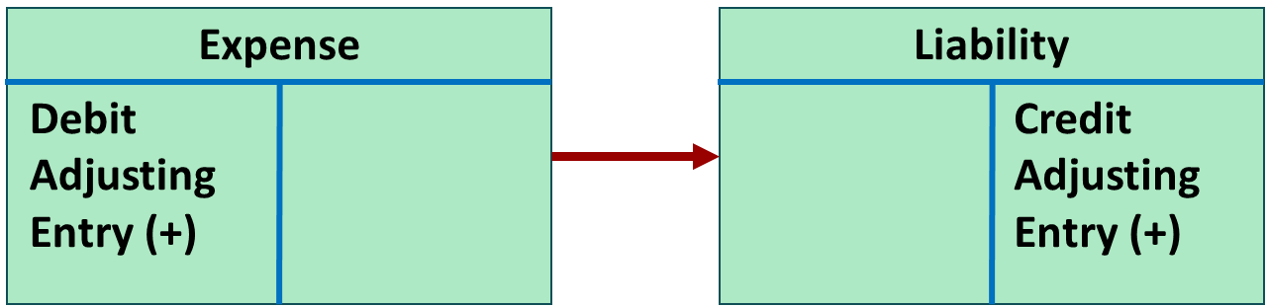
Accrued Expenses (2 of 7)
Adjusting entry records the obligation and recognizes the expense.
Adjusting entry:
Increase (debit) an expense account and
Increase (credit) a liability account.
L O 3

Slide 11
Accrued Expenses (3 of 7)
Accrued Interest
Illustration: Pioneer Advertising signed a three-month note payable in the amount of $5,000 on October 1. The note requires Pioneer to pay interest at an annual rate of 12%.
Face Value of Note | × | Annual Interest Rate | × | Time in Terms of One Year | = | Interest
$5,000 | × | 12% | × | 1 over 12 | = | $50
Oct. 31
Interest Expense
50
Interest Payable
50
L O 3

Slide 12
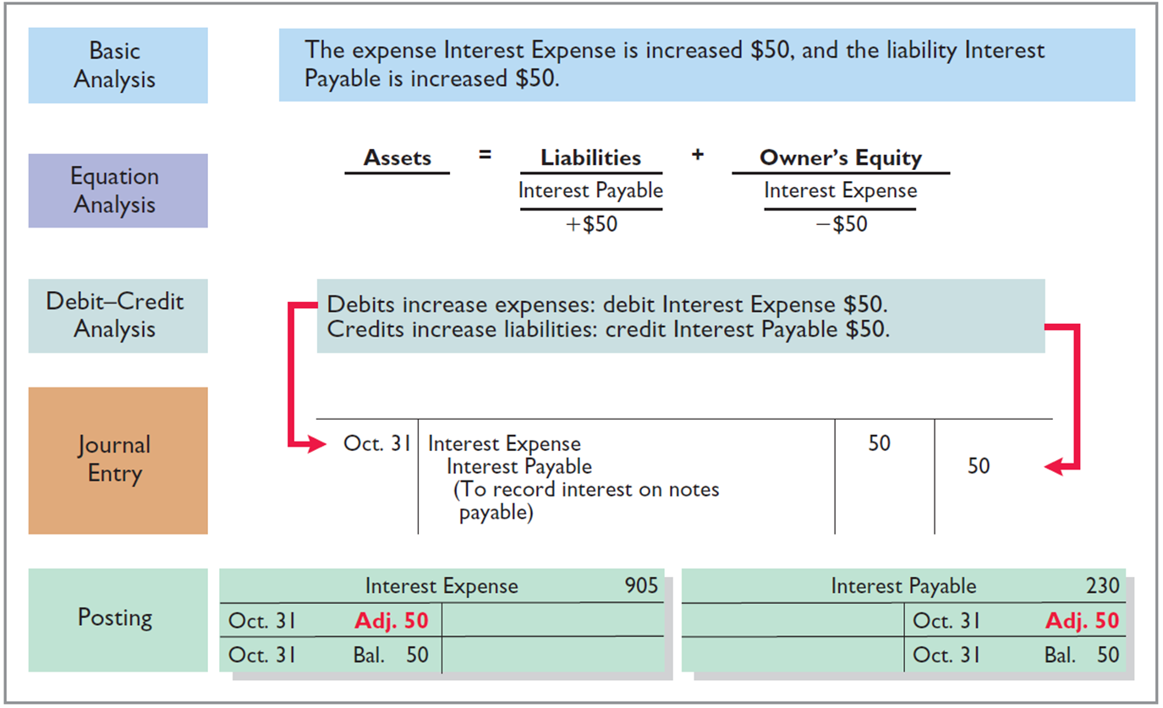
Accrued Expenses (4 of 7)
L O 3

Slide 13
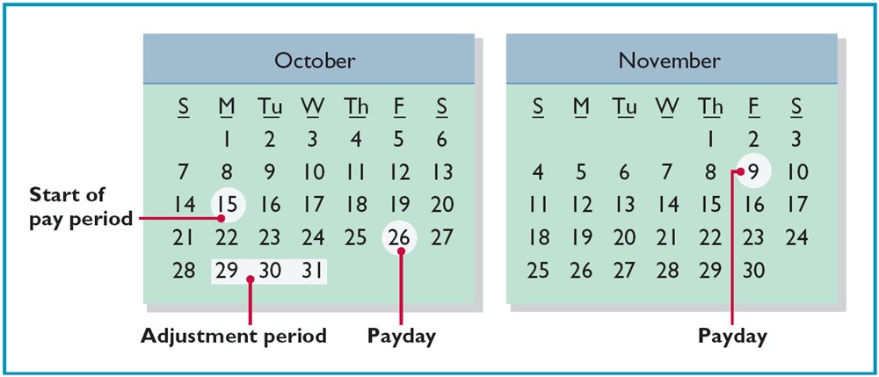
Accrued Expenses (5 of 7)
Accrued Salaries and Wages
Illustration: Pioneer Advertising paid salaries and wages on October 26; the next payment of salaries will not occur until November 9. The employees receive total salaries of $2,000 for a five-day work week, or $400 per day.
L O 3

Slide 14
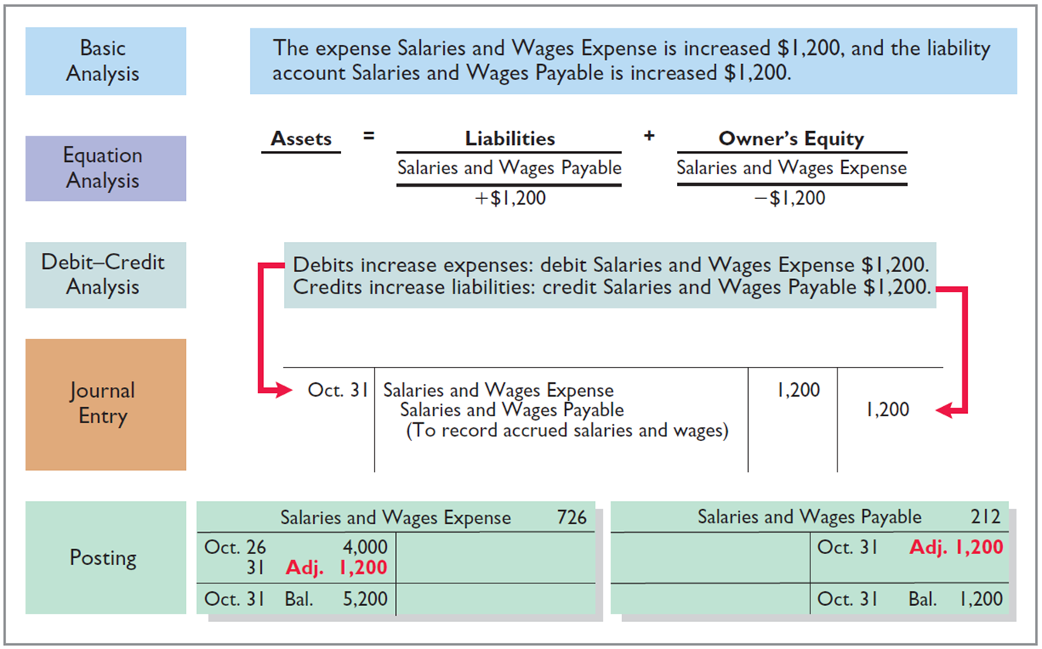
Accrued Expenses (6 of 7)
L O 3

Slide 15
Accrued Expenses (7 of 7)
Accounting for Accrued Revenues
Examples | Reason for Adjustment | Accounts Before Adjustment | Adjusting Entry
Interest, rent, salaries | Expenses have been incurred but not yet paid in cash or recorded. | Expenses understated. Liabilities understated. | Dr. Expenses Cr. Liabilities
L O 3

Slide 16
Summary of Basic Relationships
Type of Adjustment | Accounts Before Adjustment | Adjusting Entry
Prepaid expenses | Assets overstated. Expenses understated. | Dr. Expense Cr. Assets or Contra Assets
Unearned revenues | Liabilities overstated. Revenues understated. | Dr. Liabilities Cr. Revenues
Accrued revenues | Assets understated. Revenues understated. | Dr. Assets Cr. Revenues
Accrued expenses | Expenses understated. Liabilities understated. | Dr. Expenses Cr. Liabilities
L O 3

Slide 17
Do It! 3: Adjusting Entries Accruals (1 of 3)
Micro Computer Services began operations on August 1, 2020. At the end of August 2020, management prepares monthly financial statements. The following information relates to August.
At August 31, the company owed its employees $800 in salaries and wages that will be paid on September 1.
On August 1, the company borrowed $30,000 from a local bank on a 15-year mortgage. The annual interest rate is 10%.
Revenue for services performed but unrecorded for August totaled $1,100.
Prepare the adjusting entries needed at August 31, 2020.
L O 3

Slide 18
Do It! 3: Adjusting Entries Accruals (2 of 3)
Prepare the adjusting entries needed at August 31, 2020.
At August 31, the company owed its employees $800 in salaries and wages that will be paid on September 1.
Salaries and Wages Expense
800
Salaries and Wages Payable
800
On August 1, the company borrowed $30,000 from a local bank on a 15-year mortgage. The annual interest rate is 10%.
Interest Expense ($30,000 .20 x 1/12)
250
Interest Payable
250
L O 3

Slide 19
Do It! 3: Adjusting Entries Accruals (3 of 3)
Prepare the adjusting entries needed at August 31, 2020.
Revenue for services performed but unrecorded for August totaled $1,100.
Accounts Receivable
1,100
Service Revenue
1,100
L O 3

Slide 20
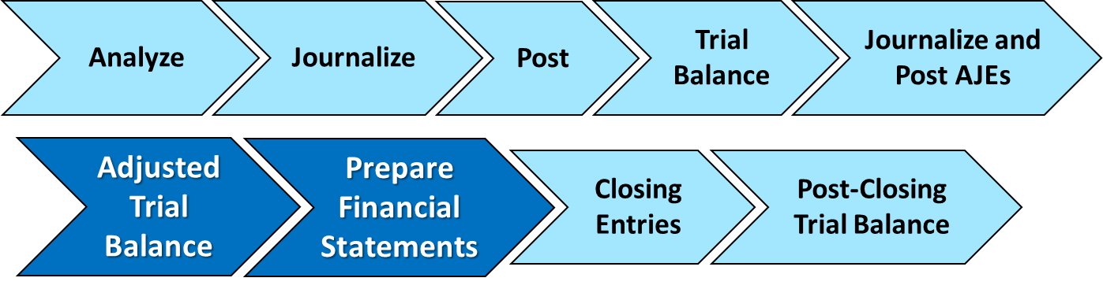
Adjusted Trial Balance
LEARNING OBJECTIVE 4
Describe the nature and purpose of an adjusted trial balance.
Prepared after adjusting entries are journalized and posted
Proves equality of debit and credit balances
Basis for the preparation of financial statements
L O 4

Slide 21
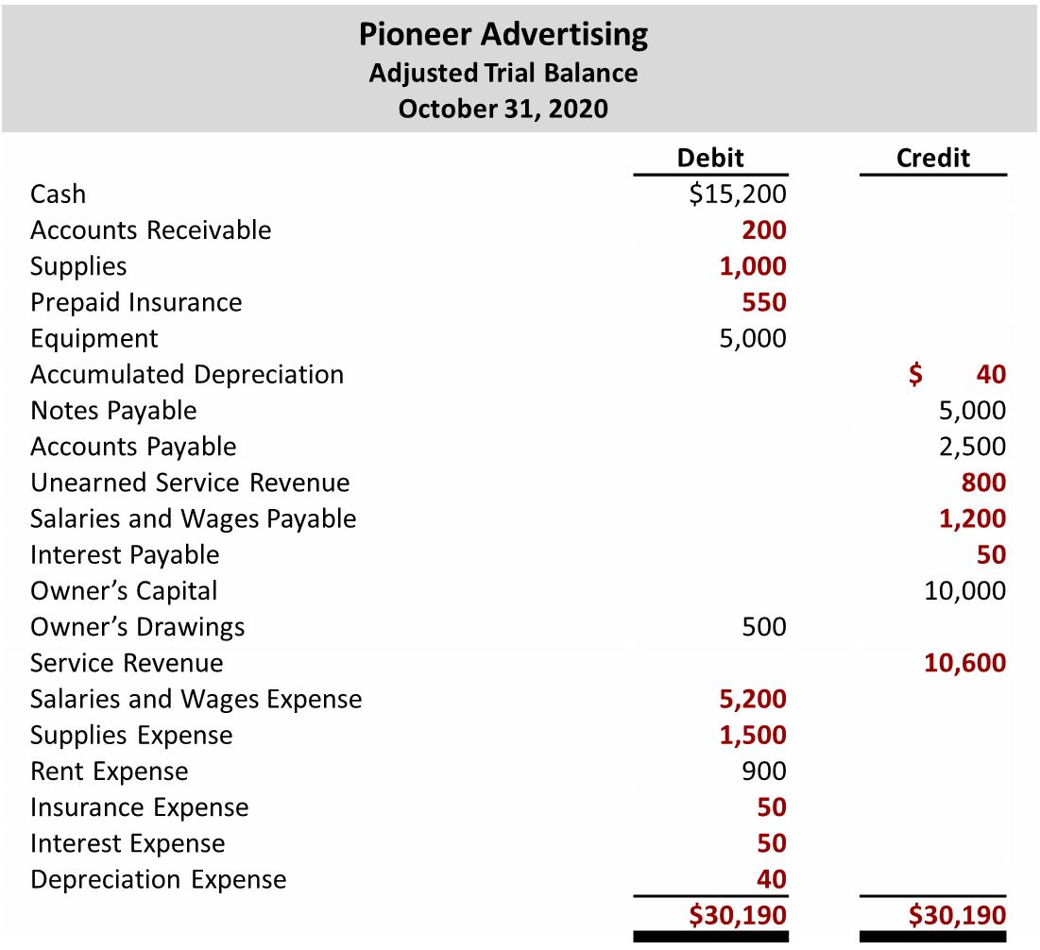
Adjusted Trial Balance (1 of 3)
L O 4

Slide 22
Adjusted Trial Balance (2 of 3)
Which of the following statements is incorrect concerning the adjusted trial balance?
a. An adjusted trial balance proves the equality of the total debit balances and the total credit balances in the ledger after all adjustments are made.
b. The adjusted trial balance provides the primary basis for the preparation of financial statements.
c. The adjusted trial balance lists the account balances segregated by assets and liabilities.
d. The adjusted trial balance is prepared after the adjusting entries have been journalized and posted.
L O 4

Slide 23
Adjusted Trial Balance (3 of 3)
Which of the following statements is incorrect concerning the adjusted trial balance?
a. An adjusted trial balance proves the equality of the total debit balances and the total credit balances in the ledger after all adjustments are made.
b. The adjusted trial balance provides the primary basis for the preparation of financial statements.
c. Answer: The adjusted trial balance lists the account balances segregated by assets and liabilities.
d. The adjusted trial balance is prepared after the adjusting entries have been journalized and posted.
L O 4

Slide 24
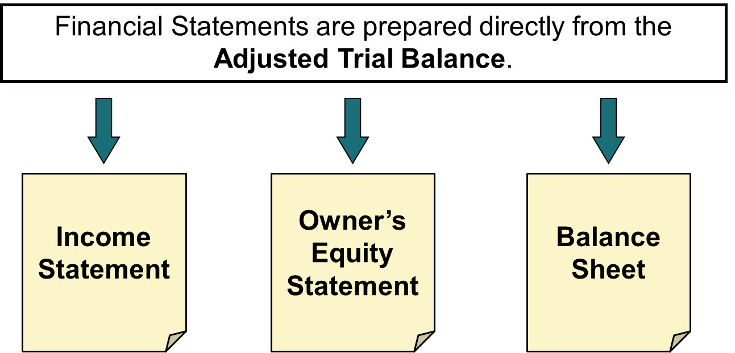
Preparing Financial Statements (1 of 3)
L O 4

Slide 25
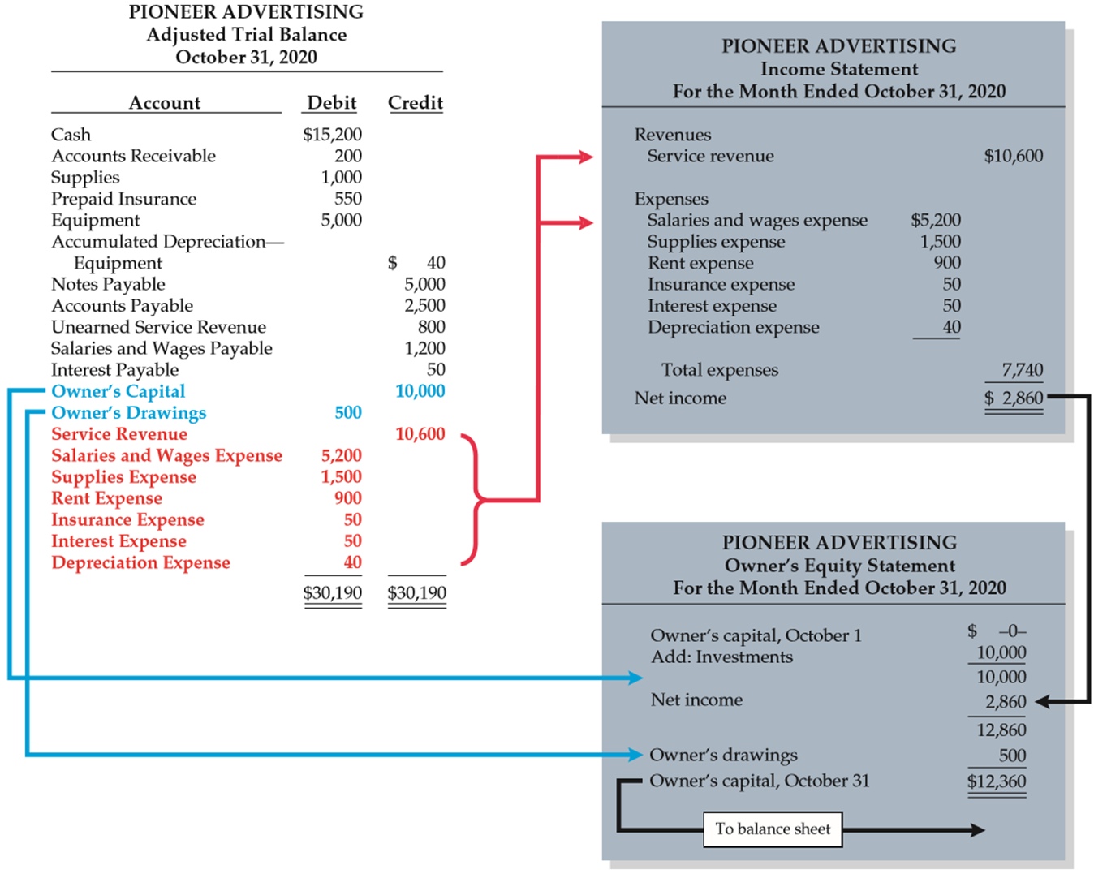
Preparing Financial Statements (2 of 3)
L O 4

Slide 26
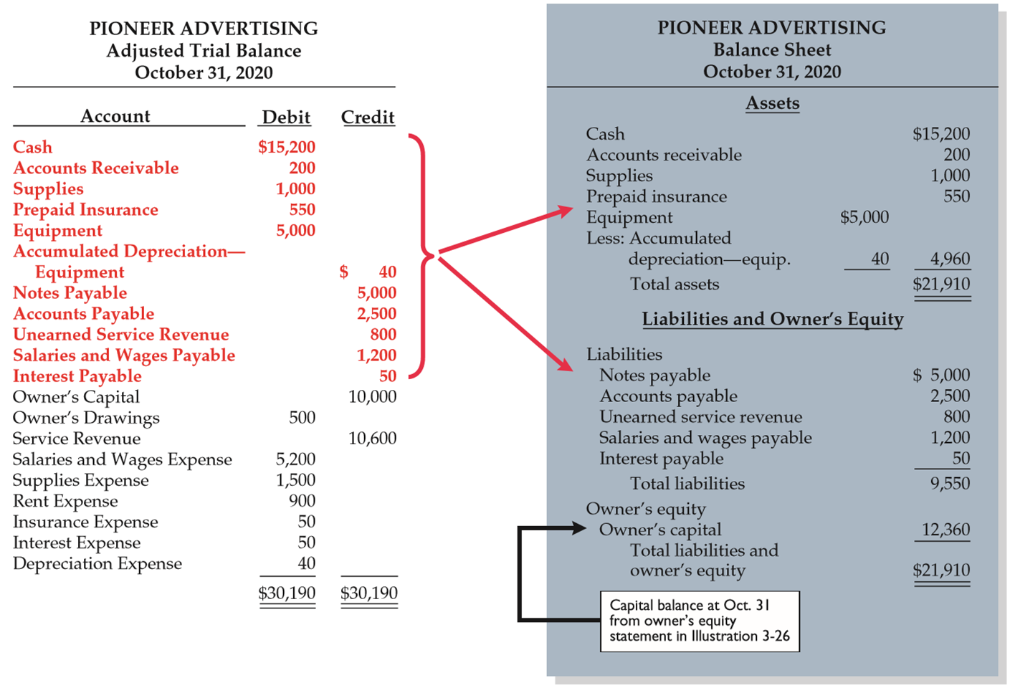
Preparing Financial Statements (3 of 3)
L O 4

Slide 27
Do It! 4: Trial Balance (1 of 4)
Skolnick Co. was organized on April 1, 2020. The company prepares quarterly financial statements. The adjusted trial balance at June 30 are shown below.
 | Debit
Cash | $ 6,700
Accounts Receivable | 600
Prepaid Rent | 900
Supplies | 1,000
Equipment | 15,000
Owner’s Drawings | 600
Salaries and Wages Expense | 9,400
Rent Expense | 1,500
Depreciation Expense | 850
Supplies Expense | 200
Utilities Expense | 510
Interest Expense | 50
 | $37,310
 | Credit
Accumulated Depreciation | $ 850
Notes Payable | 5,000
Accounts Payable | 1,510
Salaries and Wages Payable | 400
Interest Payable | 50
Unearned Rent Revenue | 500
Owner’s Capital | 14,000
Service Revenue | 14,200
Rent Revenue | 800
 | $37,310
L O 4

Slide 28
Do It! 4: Trial Balance (2 of 4)
a. Determine the net income for the quarter April 1 to June 30.
Revenues
Service revenue | $14,200
Rent revenue | 800
Total revenues |  | $15,000
Expenses
Salaries and wages expense | 9,400
Rent expense | 1,500
Depreciation expense | 850
Utilities expense | 510
Supplies expense | 200
Interest expense | 50
Total expenses |  | 12,510
Net income |  | $2,490
L O 4

Slide 29
Do It! 4: Trial Balance (3 of 4)
b. Determine the total assets and total liabilities at June 30, 2020.
 | Assets
Cash | $ 6,700
Accounts Receivable | 600
Prepaid Rent | 900
Supplies | 1,000
Equipment | 15,000
Accumulated Depreciation | (850)
Total assets | $23,350
 | Liabilities
Notes Payable | 5,000
Accounts Payable | 1,510
Salaries and Wages Payable | 400
Interest Payable | 50
Unearned Rent Revenue | 500
blank
Total liabilities | $7,460
L O 4

Slide 30
Do It! 4: Trial Balance (4 of 4)
c. Determine the amount of owner’s capital at June 30, 2020.
Owner’s capital, April 1 | $ 0
Add: Investments | 14,000
Net income | 2,490
Less: Owner’s drawings | 600
Total assets | $15,890
L O 4

Slide 31
Appendix 3A: Alternative Treatment of Deferrals
When a company prepays an expense, it debits that amount to an expense account.
When it receives payment for future services, it credits the amount to a revenue account.
L O 5

Slide 32
Prepaid Expenses (5 of 5)
Company may choose to debit (increase) an expense account rather than an asset account. This alternative treatment is simply more convenient.
Prepayment Initially Debited to Asset Account (per chapter)
Oct. 5 | Supplies | 2,500
 | Accounts payable |  | 2,500
Oct. 31 | Supplies Expense | 1,500
 | Supplies |  | 1,500
Prepayment Initially Debited to Expense Account (per appendix)
Oct. 5 | Supplies Expense | 2,500
 | Accounts payable |  | 2,500
Oct. 31 | Supplies | 1,000
 | Supplies Expense |  | 1,000
L O 5

Slide 33
Unearned Revenues (6 of 6)
Company may credit (increase) a revenue account when they receive cash for future services.
Unearned Revenue Initially Credited to Liability Account (per chapter)
Oct. 2 | Cash | 1,200
 | Unearned Revenue |  | 1,200
Oct. 31 | Unearned Revenue | 400
 | Service Revenue |  | 400
Unearned Revenue
Initially Credited to
Revenue Account
(per appendix)
Oct. 2 | Cash | 1,200
 | Service Revenue |  | 1,200
Oct. 31 | Service Revenue | 800
 | Unearned Revenue |  | 800
L O 5

Slide 34
Summary of Additional Adjustments (1 of 2)
Prepaid Expenses
Reason for Adjustment | Accounts Balances Before Adjustment | Adjusting Entry
(a) Prepaid expenses initially recorded in asset accounts have been used. | Assets overstated. Expenses understated. | Dr. Expenses Cr. Assets
(b) Prepaid expenses initially recorded in expense accounts have not been used. | Assets understated. Expenses overstated. | Dr. Assets Cr. Expenses
L O 5

Slide 35
Summary of Additional Adjustments (2 of 2)
Unearned Revenues
Reason for Adjustment | Accounts Balances Before Adjustment | Adjusting Entry
(a) Unearned revenues initially recorded in liability accounts are now recognized as revenue. | Liabilities overstated. Revenues understated. | Dr. Liabilities Cr. Revenues
(b) Unearned revenues initially recorded in revenue accounts are still unearned. | Liabilities understated. Revenues overstated. | Dr. Revenues Cr. Liabilities
L O 5

Slide 36
Appendix 3B: Financial Reporting Concepts (1 of 2)
Qualities of Useful Information
Two fundamental qualities
Relevance
Make a difference in a business decision
Provides information that has predictive value and confirmatory value
Materiality is a company-specific aspect of relevance
An item is material when its size makes it likely to influence the decision of an investor or creditor
L O 6

Slide 37
Appendix 3B: Financial Reporting Concepts (2 of 2)
Two fundamental qualities
Faithful Representation
Information accurately depicts what really happened.
Information must be
complete (nothing important has been omitted)
neutral (is not biased toward one position or another)
free from error.
L O 6

Slide 38
Qualities of Useful Information
Enhancing Qualities
Comparability results when different companies use the same accounting principles.
Information is verifiable if independent observers, using the same methods, obtain similar results.
Information has the quality of understandability if it is presented in a clear and concise fashion.
Consistency means that a company uses the same accounting principles and methods from year to year.
For accounting information to have relevance, it must be timely.
L O 6

Slide 39
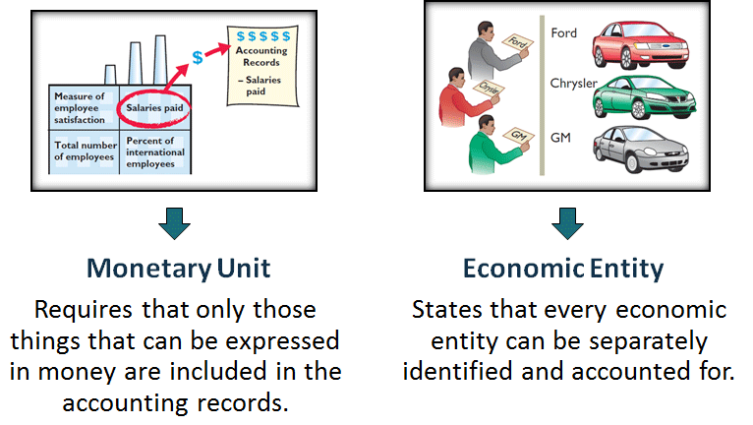
Assumptions in Financial Reporting (1 of 3)
L O 6

Slide 40
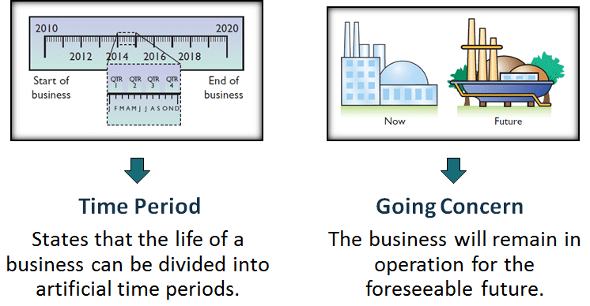
Assumptions in Financial Reporting (2 of 3)
L O 6

Slide 41
Assumptions in Financial Reporting (3 of 3)
Measurement Principles
Historical Cost
Fair Value
Or cost principle, dictates that companies record assets at their cost.
Indicates that assets and liabilities should be reported at fair value (the price received to sell an asset or settle a liability).
L O 6

Slide 42
Principles of Financial Reporting
Revenue Recognition Principle
Expense Recognition Principle
Full Disclosure Principle
Requires that companies recognize revenue in the accounting period in which the performance obligation is satisfied.
Dictates that efforts (expenses) be matched with results (revenues). Thus, expenses follow revenues.
Requires that companies disclose all circumstances and events that would make a difference to financial statement users.
L O 6

Slide 43
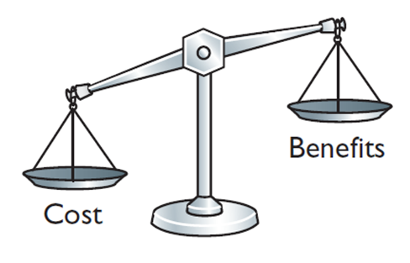
Cost Constraint
Cost Constraint
Accounting standard-setters weigh the cost that companies will incur to provide the information against the benefit that financial statement users will gain from having the information available.
L O 6

Slide 44
A Look at I F R S (1 of 5)
Key Points
Similarities
Companies applying I F R S also use accrual-basis accounting to ensure that they record transactions that change a company’s financial statements in the period in which events occur.
Similar to G A A P, cash-basis accounting is not in accordance with I F R S.
I F R S also divides the economic life of companies into artificial time periods. Under both G A A P and I F R S, this is referred to as the time period assumption.
L O 7

Slide 45
A Look at I F R S (2 of 5)
Key Points
Similarities
The general revenue recognition principle required by G A A P that is used in this textbook is similar to that used under I F R S.
Revenue recognition fraud is a major issue in U.S. financial reporting. The same situation occurs in other countries, as evidenced by revenue recognition breakdowns at Dutch software company Baan N V, Japanese electronics giant N E C, and Dutch grocer Ahold N V.
L O 7

Slide 46
A Look at I F R S (3 of 5)
Key Points
Differences
Under I F R S, revaluation (using fair value) of items such as land and buildings is permitted. I F R S allows depreciation based on revaluation of assets, which is not permitted under G A A P.
The terminology used for revenues and gains, and expenses and losses, differs somewhat between I F R S and G A A P. For example, income includes both revenues, which arise during the normal course of operating activities, and gains, which arise from activities outside of the normal sales of goods and services. The term income is not used this way under G A A P. Instead, under G A A P income refers to the net difference between revenues and expenses.
L O 7

Slide 47
A Look at I F R S (4 of 5)
Key Points
Differences
Under I F R S, expenses include both those costs incurred in the normal course of operations as well as losses that are not part of normal operations. This is in contrast to G A A P, which defines each separately.
L O 7

Slide 48
A Look at I F R S (5 of 5)
Looking to the Future
The I A S B and F A S B are completing a joint project on revenue recognition. The purpose of this project is to develop comprehensive guidance on when to recognize revenue. It is hoped that this approach will lead to more consistent accounting in this area.
L O 7

Slide 49
Copyright
Copyright © 2018 John Wiley & Sons, Inc.
All rights reserved. Reproduction or translation of this work beyond that permitted in Section 117 of the 19 76 United States Act without the express written permission of the copyright owner is unlawful. Request for further information should be addressed to the Permissions Department, John Wiley & Sons, Inc. The purchaser may make back-up copies for his/her own use only and not for distribution or resale. The Publisher assumes no responsibility for errors, omissions, or damages, caused by the use of these programs or from the use of the information contained herein.

